Slide 1
The Endocrine system
Specific organs and glands

Slide 2
Hypothalamus and Pituitary gland
The hypothalamus controls many body functions such as temperature, water balance and heart rate by it’s control of the pituitary gland.

Slide 3
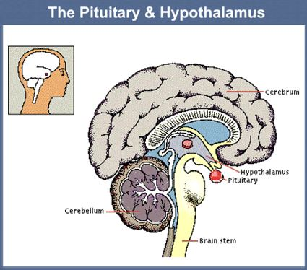
Hypothalamus and Pituitary gland
The hypothalamus is located at the base of the brain.
It is joined to the pituitary gland by a stalk called the infundibulum.
The pituitary is no bigger than a pea and is shaped as two lobes

Slide 4
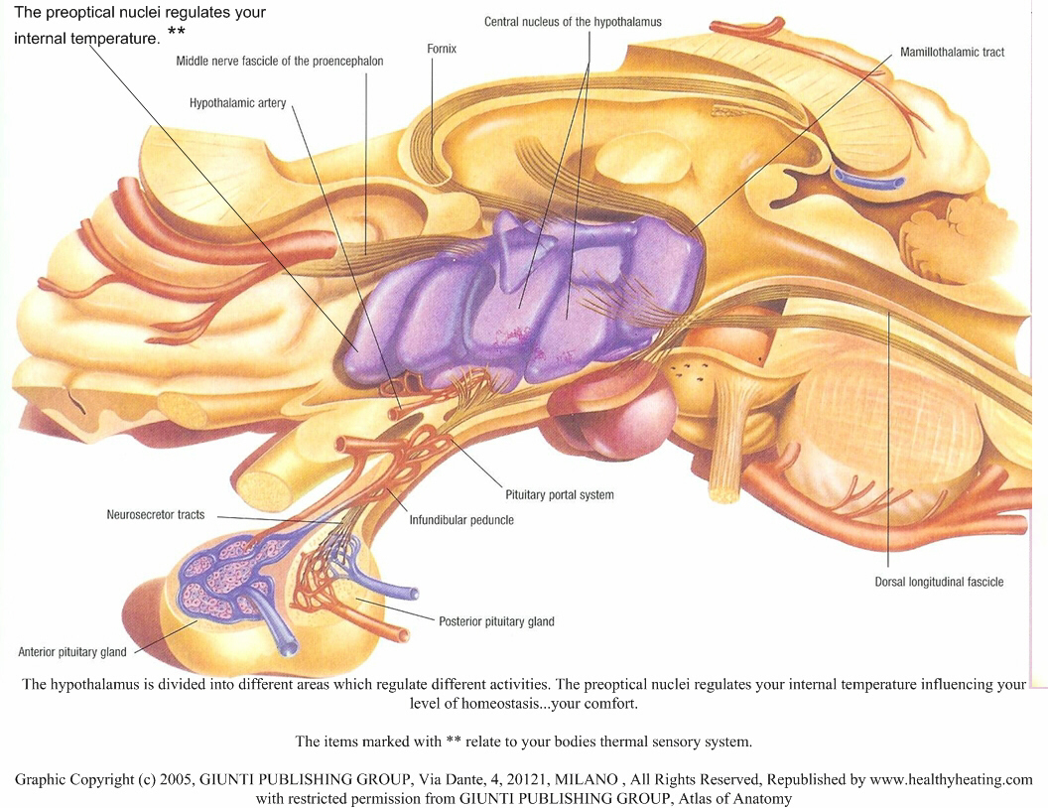

Slide 5
Pituitary gland
Consists of two lobes – anterior and posterior.
The posterior (rear) is joined to the hypothalamus by nerves. Does not manufacture hormones.
The anterior (front) is joined to the hypothalamus by blood vessels.

Slide 6
Role of the hypothalamus
Produces hormones that are carried to the pituitary gland.
Some enter the blood stream and stimulate or inhibit hormone production in the anterior.
Other hormones pass through the nerve fibres to the posterior where they are secreted.
The pituitary secretes hormones that control other endocrine glands.

Slide 7
Anterior lobe release…
Gonadotropins – target the ovaries or testes.
e.g. Follicle stimulating hormone (FSH) stimulates the development of the follicle which contains the egg. In males it stimulates the production and maturation of sperm.
e.g. Luteinising hormone (LH) forms the corpus luteum in the female and in the male stimulates the testes to secrete male sex hormones.

Slide 8
Anterior lobe release…
Growth hormone (GH) – stimulates growth of the skeleton, increases amino acid uptake to build proteins. GH continues to be secreted through life to maintain organ size
Thyroid stimulating hormone (TSH) – stimulates hormone production in the thyroid
Adrenocorticotropic hormone (ACTH) – stimulates hormone production in the adrenal cortex
Prolactin – initiates and maintains milk secretion in females.

Slide 9
Posterior lobe release…
Oxytocin – stimulates contraction of the muscles of the uterus. Also stimulates contraction of cells in the mammary glands causing the release of milk.
Antidiuretic hormone (ADH) – causes increased reabsorption of water from the kidneys.

Slide 10
The thyroid glands
Major hormone released is thyroxine – it stimulates carbohydrate, protein and fat metabolism.
It effects nearly every tissue in the body
Regulates the base metabolic rate
Important in body changes needed between summer and winter.

Slide 11
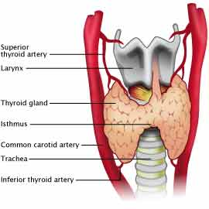
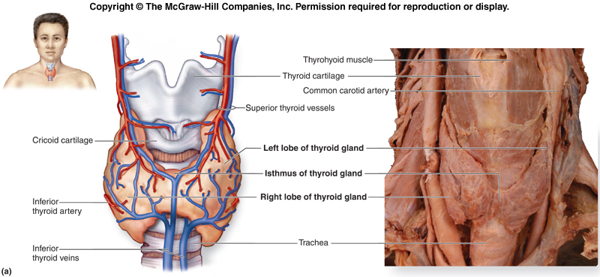

Slide 12
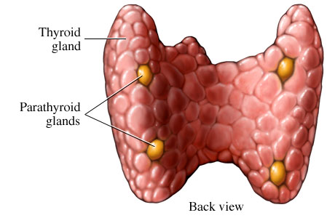
Parathyroid glands
Secrete parathyroid hormone (PTH) which controls calcium and phosphate levels in the blood.

Slide 13
Calcium levels
In response to low calcium levels PTH is released which:
  Calcium released from bones into blood
  Increased absorption of Calcium in the intestine
  Increased Calcium reabsorption in the kidney

Slide 14
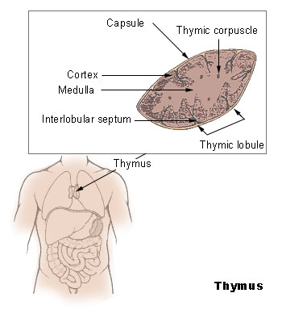
Thymus
Secrete thymosins which influence the maturation of T-lymphocytes.

Slide 15
The adrenal gland
Adrenal medulla – Secretes adrenaline (fight or flight response) and noradrenaline (increase in rate and force of heart beat).
Adrenal cortex – corticosteroids.
Aldosterone reduces the amount of sodium and increases the amount of potassium in urine. Cortisol promotes normal metabolism – helps the body to withstand stress.

Slide 16
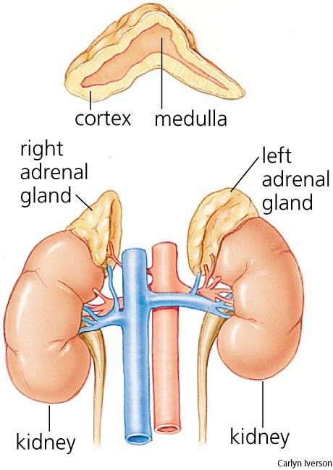

Slide 17
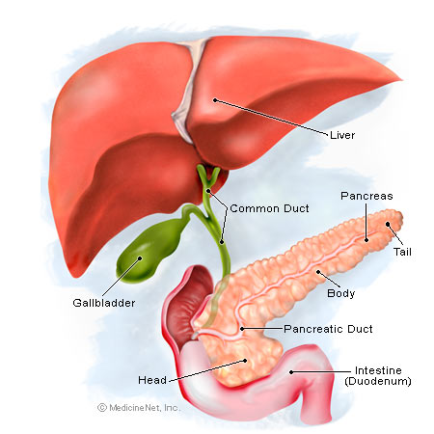
The pancreas
Islets of Langerhans release insulin and glucagon which regulate blood sugar level

Slide 18
The gonads
Testes produce androgens which maintain the male sexual characteristics.
Ovaries produce oestrogens and progesterone. They stimulate and maintain female sexual characteristics. Along with the gonadotropins regulate the menstrual cycle.

